Slide 1

Liability
Products
Dan Wu
Bodian Li

Slide 2


Definition of
Liability

Slide 3

Definition of liability
Perspective of Balance sheet
What is liability?
obligation that arises from past business event or personal event
Liabilities for individuals
Mortgage, credit card debt, auto loans, student loans, payables (utility bills or cell phone bills)
Liabilities for corporates
Short term debt
Long term debt
Payables (wage payable, account payables, tax payables)
Accrued liabilities: an expense that a business has incurred but has not yet paid
(Difference between Payables and Accrued Liabilities: billed or not?)
Other liabilities

Slide 4
Shareholders’
Equity

Slide 5
Shareholders’ Equity
Type of Equity
Common Equity
Common stock: a security that represents ownership in a corporation. Usually traded on stock exchange; if unlisted, will be traded over the counter. (outstanding common stock * face value)
Additional paid in capital: amount above par value of stock by investors, can only be recorded at IPO.
Retained earnings: amount from net income left over for the business after it has paid out dividends to its shareholders
Preferred Equity
Also a form of ownership in the company. Comes with higher claim in dividend or asset distribution compared to common shareholders; has limited rights, which usually does not include voting.

Slide 6
Balance Sheet
Example

Slide 7
Balance Sheet Example
Insurance
Liabilities
Unpaid Claim
Other Payables
Unearned Premium
Short-term Debt
Long-term Debt
Other Liabilities
Equity
Unearned premium:
Portion of the policy that has not been serviced yet
Only when the time period has passed, the amount can be recognized as profit

Slide 8
Balance Sheet Example
Investment Company (Private Equity)
Liabilities
Payables
Management Fee Payables
Capital Distribution Payable
Other Payables
Accrued Expenses
Partners’ Capital

Slide 9
Balance Sheet Example
Investment Banking
Liabilities
Deposit
Collateralized Financing
Securities Sold Under Agreement to Repurchase
Securities Loaned
Other Secured Financing
Customer Payables
Unsecured Borrowings
Collateralized financing:
Involves repurchase or resale agreement, securities loaned, and other secured financing.
Companies enter into these transactions in order to, among other things, facilitate client activities, invest excess cash, acquire securities to cover short positions and finance certain firm activities.

Slide 10
Balance Sheet Example
Banks
Liabilities
Retail Deposits
Commercial Deposits
Short-term Debt
Long-term Debt
Securitization
Repo
Other Liabilities
Trading Liabilities
Equity

Slide 11
Definition of liability
Trading Book VS Banking Book
Trading Book
The trading book refers to assets held by a bank that are available for sale and hence regularly traded. The trading book is required under Basel II and III to be marked-to-market on a daily basis)
Banking Book
The banking book is a term for assets on a bank's balance sheet that are expected to be held to maturity, usually consisting of customer loans to and deposits from retail and corporate customers.

Slide 12
Bank’s
Liability

Slide 13
Bank’s Liability
Deposit Matrix
Counterparty
Retail; commercial; broker; SME and etc
Maturity
Open maturity; 7 days advance; less than 1 year; long than 1 year
Collateralized
Unsecured; secured (most for government depositors)
Interest Bearing
Non-interesting bearing; interest bearing; fixed; floating

Slide 14
Bank’s Liability
Debt Matrix
Seniority
Senior debt; subordinate debt
Maturity
Less than 30 days; less than 1 year (T Bill); longer than 1 year (T Note); longer than 10 years (T Bond); no maturity (Perpetual Bond)
Collateralized
Secured; unsecured
Convertible (comes with the right to convert to common stocks)

Slide 15
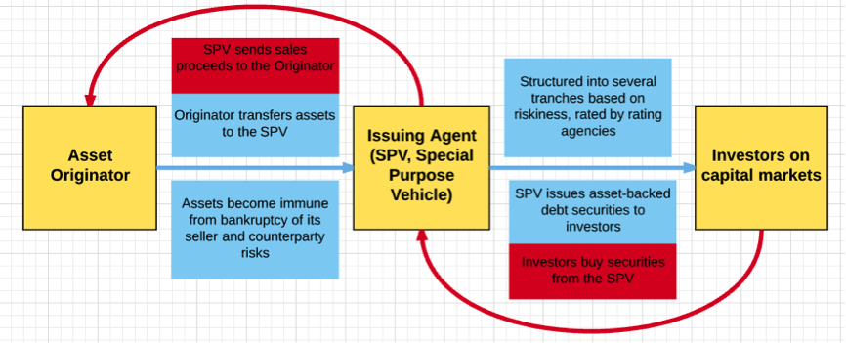
Bank’s Liability
Securitization
An issuer designs a marketable financial instrument by merging or pooling various financial assets into one group.
Loans are treated as sales to an SPE (special purpose entity).
Depending on whether variable interest hold within the SPE, the securitization may still be consolidated in the final balance sheet.

Slide 16
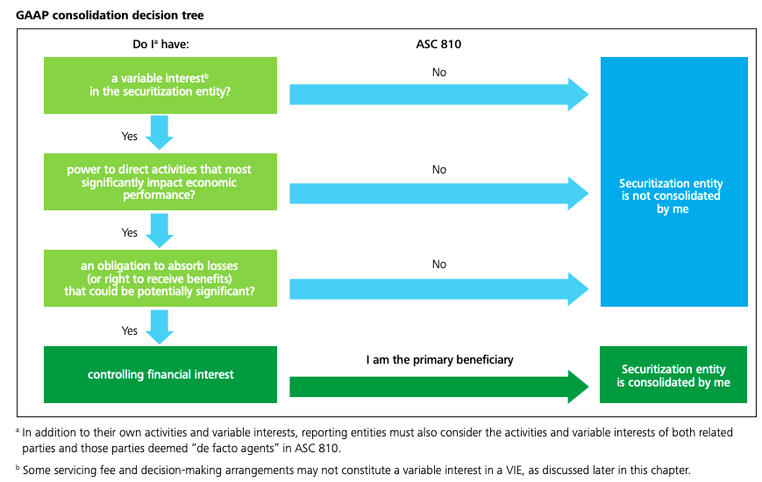
Bank’s Liability
Securitization

Slide 17
Bank’s
Capital

Slide 18
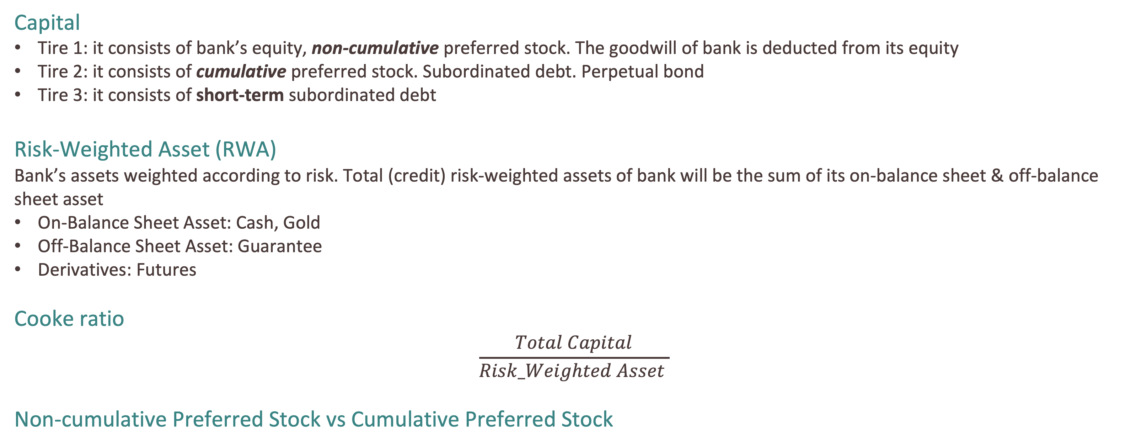
Bank’s Capital
Introduction
Capital
Tire 1: it consists of bank’s equity, non-cumulative preferred stock. The goodwill of bank is deducted from its equity
Tire 2: it consists of cumulative preferred stock. Subordinated debt. Perpetual bond
Tire 3: it consists of short-term subordinated debt
Risk-Weighted Asset (RWA)
Bank’s assets weighted according to risk. Total (credit) risk-weighted assets of bank will be the sum of its on-balance sheet & off-balance sheet asset
On-Balance Sheet Asset: Cash, Gold
Off-Balance Sheet Asset: Guarantee
Derivatives: Futures
Cooke ratio
$$\frac{Total Capital}{Risk_Weighted Asset }$$
Non-cumulative Preferred Stock vs Cumulative Preferred Stock

Slide 19

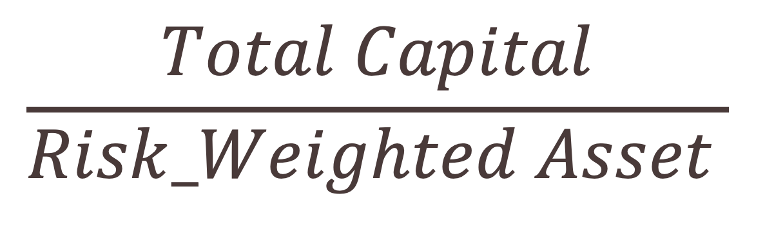
Bank’s Capital
Basel $𝔩$
$$\frac{Total Capital}{Risk_Weighted Asset }$$
Credit Risk
Total Capital should be grater than 8% of RWA
Tire 1 Capital should be greater than 50% of Total Capital
Common equity should be greater than 2% of RWA

Slide 20

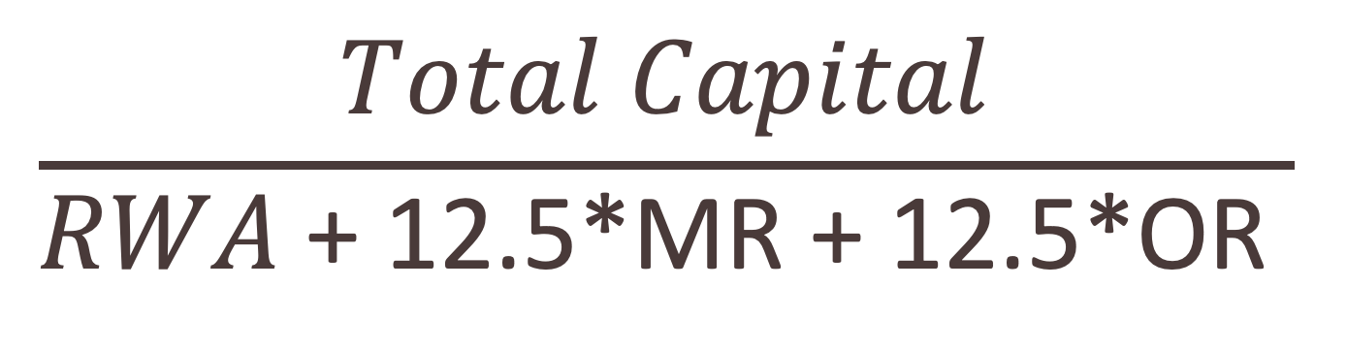
Bank’s Capital
Basel $𝔩𝔩$
$$\frac{Total Capital}{RWA \text{+ 12.5*}\text{MR}\text{ + 12.5*}\text{OR} }$$
Credit Risk
Market Risk
Operation Risk
Total Capital should be grater than 8% of RWA
Tire 1 Capital should be greater than 50% of Total Capital
Common equity should be greater than 2% of RWA

Slide 21

Bank’s Capital
Basel $𝔩𝔩𝔩$
Improvement
Amount of Capital is enough. Focus quality of capital.
Procyclical Deleveraging.
Calculation of RWA should improve because so many company have off-balance sheet business but don’t present clear in capital.
Liquidity risk
Delete Tire 3 and identify two layers of Tire 1 capital (Core & Additional)
Total Capital should be grater than 8% of RWA
Total Tire 1 Capital should be grater than 6% of RWA
Tire 1 Core capital must be at least 4.5% of RWA
Additional Buffer (Capital Conversion & Countercyclical)

Slide 22


Thank You

